Slide 1
Protect your cloud workload from threats using Azure Security Center
Abbas Kudrati
Chief Cybersecurity Advisor
Microsoft Asia
https://aka.ms/abbas
BRK3188

Slide 2




The era of flux and transformation
Everyone is now in the technology business
Conventional security tools have not kept pace
Security professionals
alone can’t fill the gap
Regulatory requirements and costs are increasing

Slide 3




Intelligent security
Identity and access management
Your universal platform to manage and secure identities
Threat protection
Stop attacks with integrated and automated security
Information protection
Protect your sensitive data—wherever it lives or travels
Cloud security
Safeguard your cross-cloud resources

Slide 4




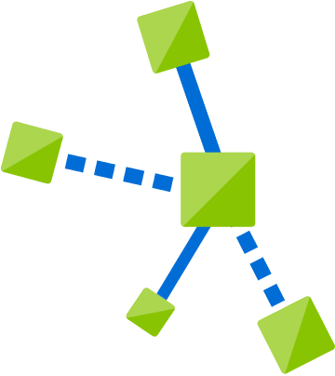


Threat actors leverage a variety of exposures to breach
Exposure
Access
Lateral movements
Actions
Insecure
configuration
Virtual machines
Virtual machines
Data loss
Vulnerabilities
Apps
Apps
Data exfiltration
Infected admin
Credentials
Credentials
Ransomware
Open entry points
Data stores
Data stores
Exposed credentials
Resource abuse
IoT devices
IoT devices
Compromised user

Slide 5







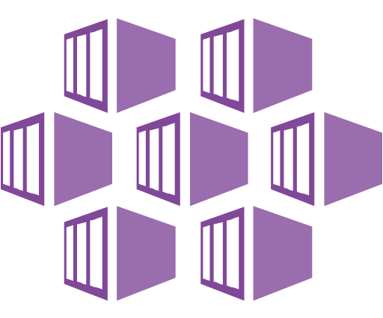

Workloads become heterogenous and hybrid
Web App
Blob storage
Azure VM
Azure Key Vault (AKV)
</>
Azure Kubernetes Services (AKS)
Azure SQL
Azure Container Registry (ACR)
Private Datacenter / Other clouds

Slide 6
Common threats we see in the wild
VMs
Containers
App services
Brute force of open management ports
Exploit through an unpatched vulnerability
Run bitcoin mining on a compromised VM
Exposed Kubernetes dashboards
RBAC not configured in the cluster
Insecure container/host configuration
Web shell deployment
server-side request forgery (SSRF)
Reconnaissance attempts
SQL Database
Storage account
Key Vault
Use to propagate malware or load malicious images/packages
Access by a remote threat actor
Public access to storage accounts
Harvest for reconnaissance or exfiltration of data
Permissive policies grant access to unneeded resources
Harvest for secrets
SQL injection vulnerabilities and attacks
Access by a remote threat actor
Brute-force against SQL credentials

Slide 7
Gain unmatched security with Azure
v
v
Microsoft Azure
$1B annual investment in cybersecurity
3500+ global security experts
Trillions of diverse signals for unique intelligence

Slide 8



Azure security center
1
Strengthen security posture
Protect against threats
Cloud security posture management
For servers
For cloud native workloads
For databases and storage
Secure Score
Policies and compliance
Get secure faster

Slide 9

Protect your workloads from threats Use industry’s most extensive threat intelligence to gain deep insights
Azure Security Center
Detect & block advanced malware and threats for Linux and Windows Servers on any cloud
Apps
VMs/
Servers
Containers
SQL
IoT
Protect cloud-native services from threats
Network
management
Protect data services against malicious attacks
Protect your Azure IoT solutions with near real time monitoring
Service layer detections: Azure network layer and Azure management layer (ARM)
Cloud workload protection

Slide 10
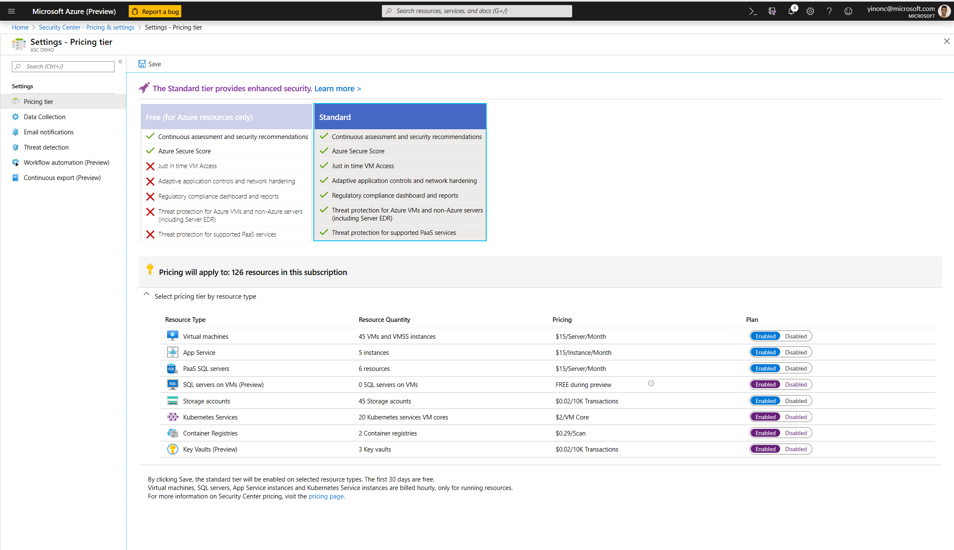
Ignite
2018
Ignite
2019
Get secure fast, just turn it ON

Slide 11
Protect Linux and Windows VMs from threats
Reduce open network ports:
Use Just-in-Time to avoid exposure of management ports
Limit open ports with adaptive network hardening
Protect against malware:
Block malware with adaptive application controls
Built-in Microsoft Defender ATP EDR
Crash dump analysis and fileless attack detections
On-premise
Azure, AWS, and GCP
Antimalware
Defender ATP
Behavior analytics
App control
!
!
!
Malicious code execution
Data exfiltration
Lateral Movement

Slide 12

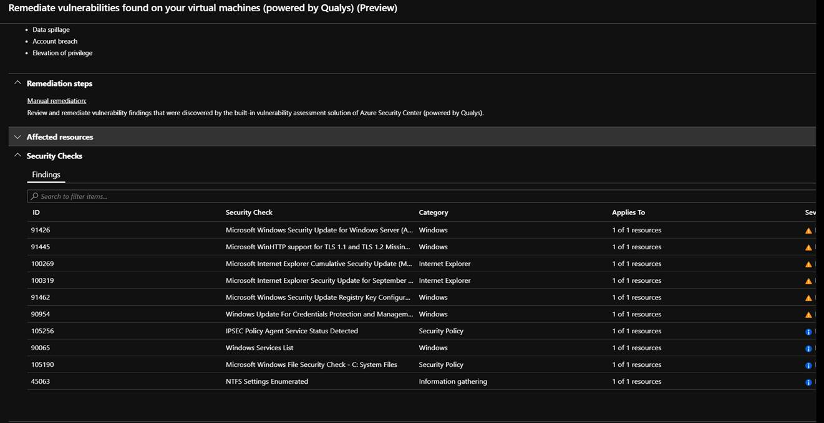
Announcing built-in vulnerability assessment for VMs
Available as part of standard ASC for VM pricing, no extra charge
Automated deployment of the vulnerability scanner
Continuously scans installed applications to find vulnerabilities
Visibility to the vulnerability findings in Security Center portal and APIs

Slide 13
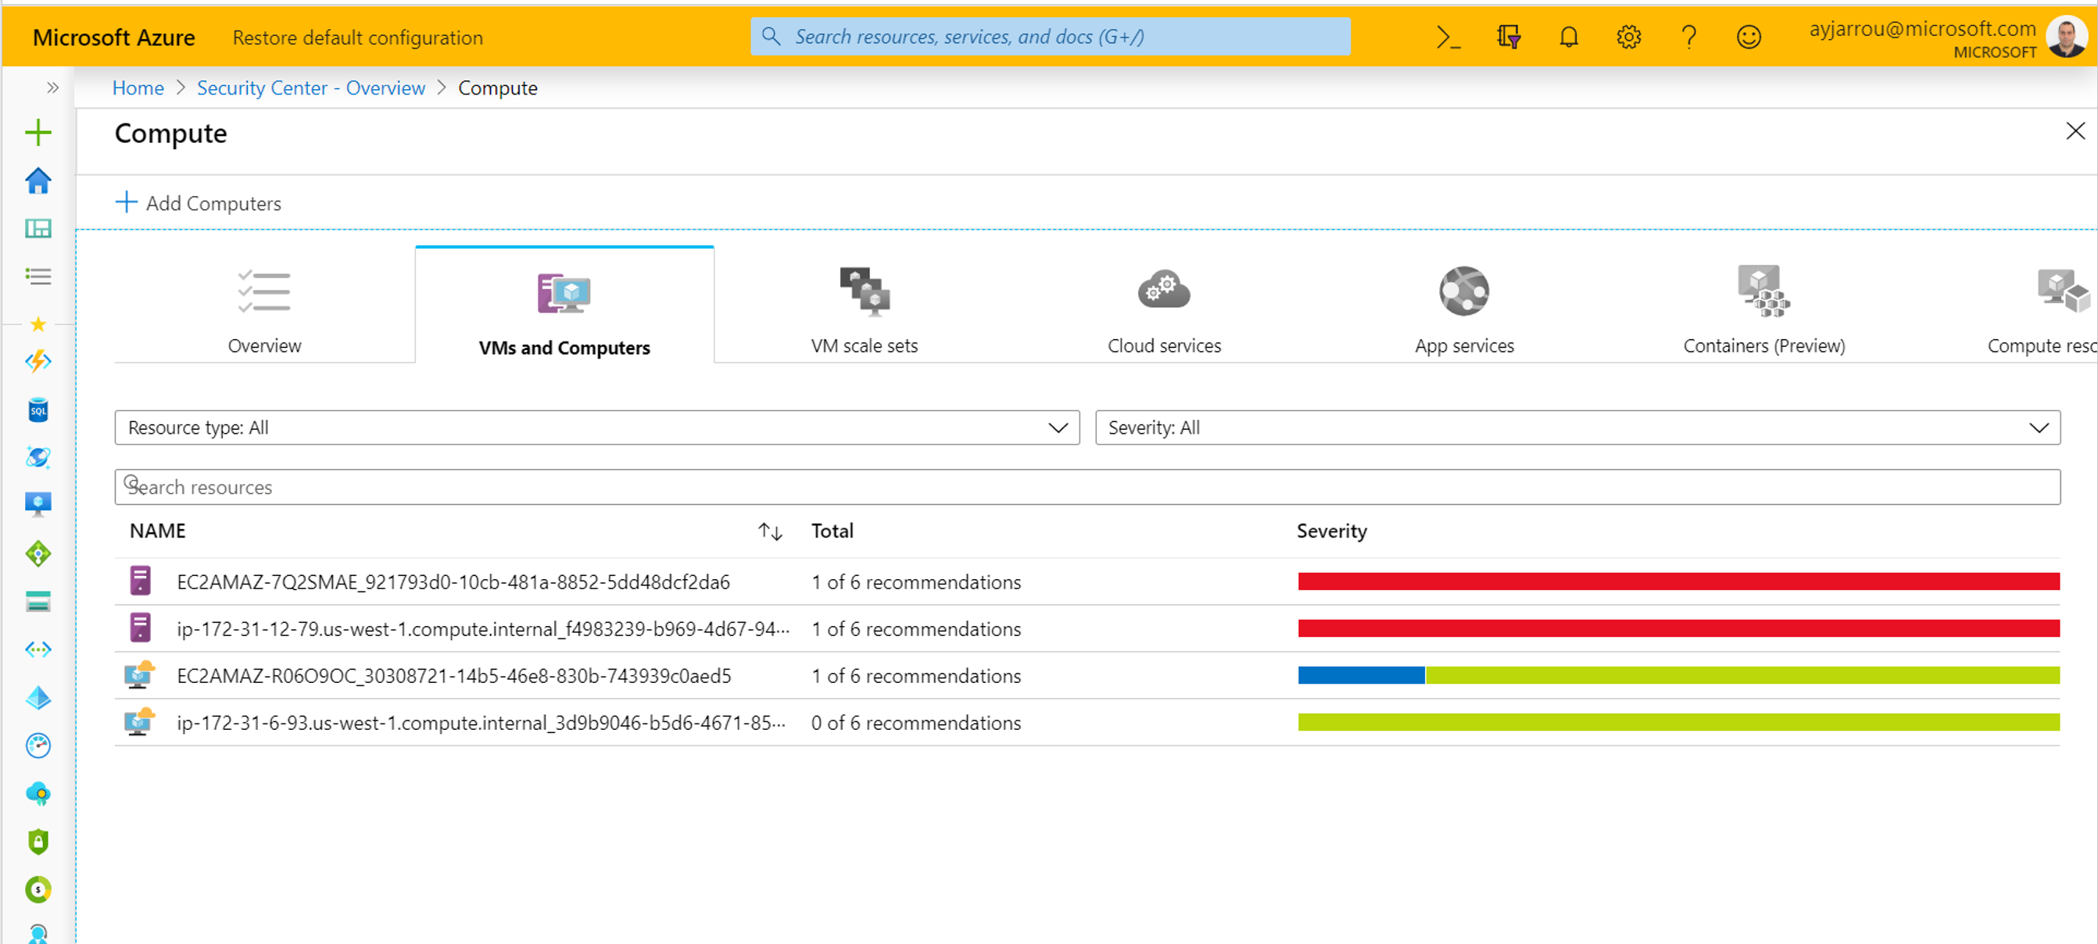


Protect hybrid datacenters and multi-cloud with Azure security center
Hybrid Server protection for Datacenters and other clouds
Onboard on-prem servers to Security Center from Windows Admin Center
Auto-onboard AWS EC2 instances using a new API connector (preview)

Slide 14
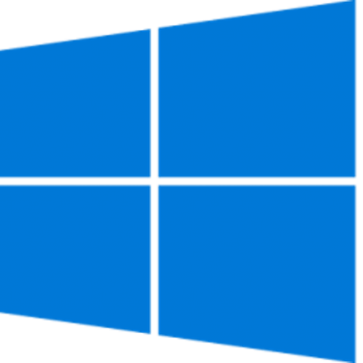


Cloud workload protection for hybrid VMs and servers
Automatic onboarding & extending to hybrid cloud
Server security hygiene
File integrity monitoring
Central management
Azure
Cloud native network security controls
Adaptive application control
Built-in vulnerability Assessment
Reduce attack surface
Data center
Built-in EDR with Microsoft Defender ATP
Detect and block advanced threats for servers
Cloud-native detections
Detect advanced threats
Other clouds

Slide 15
Server & VM threat protection with Azure Security Center
Demo

Slide 16

Protect cloud-native workloads from threats
Detect and alert on abnormal admin behavior or compromised web applications
Protects VMSS and containers from malicious attacks
CIS benchmark for Dockers on Linux IaaS & vulnerability scanning on ACR images
Azure Web Apps
VMSS
Containers
!
!
!
>75% of global organizations will be running containerized applications in production by 2022 (Gartner)

Slide 17
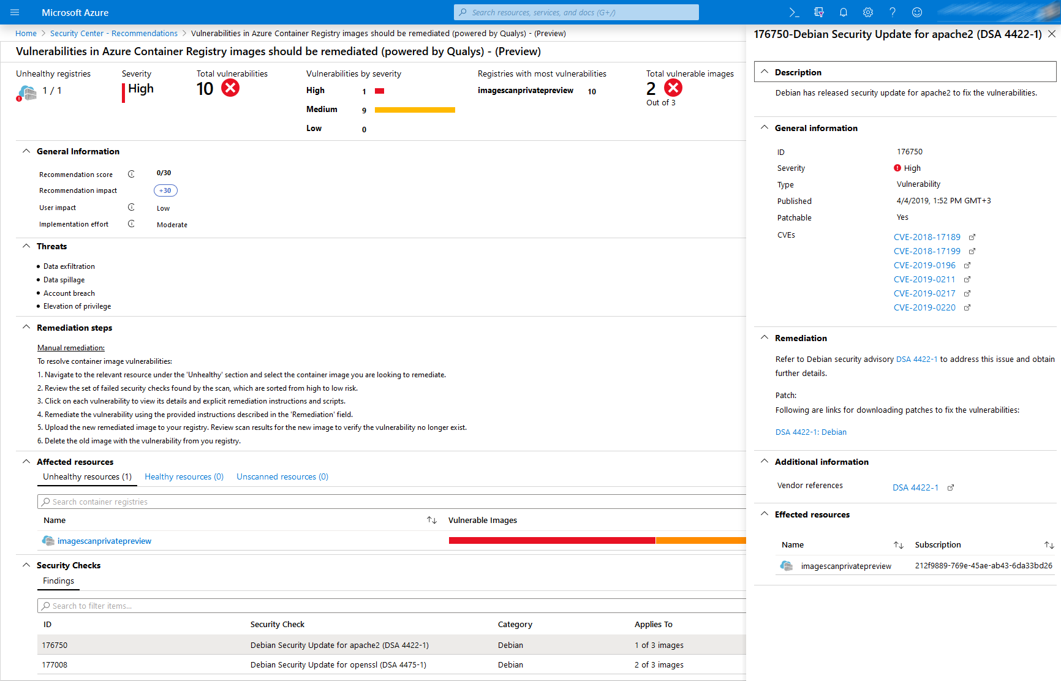
Built-in vulnerability assessment for container images
Public preview available in standard ASC with a new container registries add-on
Seamless deployment and configuration of the vulnerability scanner
Scan container images for vulnerabilities upon push to an ACR
Visibility to vulnerable ACR container images including vulnerabilities details, severity classification and guidance to remediation

Slide 18
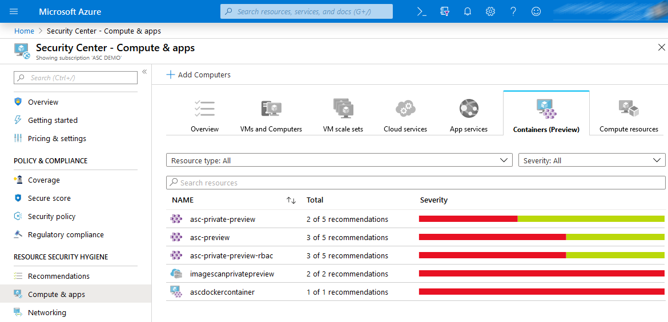
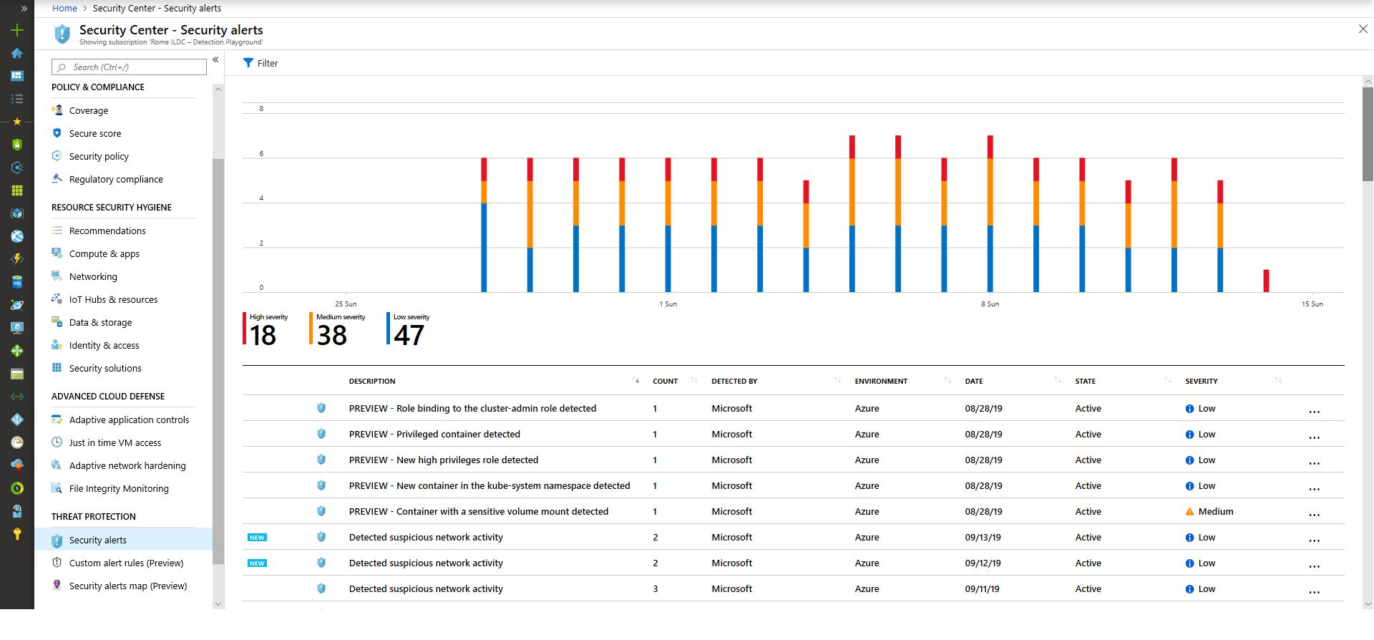
Cloud workload protection for containers
Now available in standard Azure security center with the new container service add-on
Protecting Container hosts (IaaS)
CIS Docker Benchmark assessment
Node Threat Protection
Protecting AKS
Actionable recommendations based on AKS best practices
Cluster and Node Threat detection based on AKS audit log and Node Auditd

Slide 19

Protecting against advanced cloud threats
Recommending to use RBAC on K8s
2
Detects suspicious request to K8s API
Master Node
3
Detects privileged container
API Server
Detects crypto mining image
Detects sensitive volume mount
Threat
Actor
Azure VM
Exploit
1
2
API request (deploy container)
3
Privileged w/ crypto miner & root access to Node 3
Node 1
Node 2
Node 3
Container
Vulnerable application
Malicious container
Container
Container
Container
Azure VM
Azure VM
Azure VM

Slide 20





Protect data services from threats
Prevent & detect threats targeting your Azure SQL databases, My SQL, PostgreSQL
Discover and remediate security misconfigurations in Azure SQL databases
Storage account protection to detect threats and misuse
Discover, classify, label and protect sensitive data in your Azure SQL databases
!
SQL
MySQL
PostgreSQL
Azure Storage

Slide 21

New advanced protection capabilities for data services Now in preview
Protect SQL servers on Azure VMs
Vulnerability assessment and Advanced Threat Protection to prevent and detect threats across SQL estate in Azure
Malware reputation screening for Azure Storage
Detect advanced threats in Azure Storage with hash reputation analysis upon upload
Advanced Threat Protection for Azure Key Vault
Detect unusual and potentially harmful attempts to exploit Azure Key Vault

Slide 22
Detections of the common cloud threats
SQL Database detections
Now available for SQL on IaaS
Storage account detections
Key vault detections
Now available in NA regions
Malware reputation screening or suspicious files (.cspkg)
Access anomalies by location, principal, or application
Permission change anomalies, anonymous access detection
And more…
Access from a suspicious location, Tor network
Unusual policy change or listing and secret get
Unusual volume or pattern of Key Vault operations
And more…
SQL injection vulnerabilities and attacks
Access anomalies by location, principal, or application
Brute-force against SQL credentials
And more…

Slide 23
Example solution architecture on Azure
Web App
Blob storage
Azure VM
Azure Key Vault (AKV)
</>
Azure Kubernetes Services (AKS)
Azure SQL
Azure Container Registry (ACR)
Private Datacenter / Other clouds

Slide 24
Azure security center enterprise integrations

Slide 25
Driving threat protection through the organization
Through a central SecOps & cloud governance role
Governance
SecOps
Requirements
Requirements
Findings
Requirements
Requirements
Findings
Findings
Requirements
Findings
Findings
Team 1
Team 2
Team 3
Team 4
Team 5

Slide 26

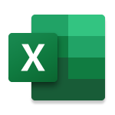




Threat protection for cloud at scale: Export assessments and alerts for security roles
Microsoft 365
App
Network
IoT
Partner solutions
Multi-cloud
SQL
Azure Security Center
Access
ASC Connector
Azure
Sentinel
SIEM
IoT
Compute
Network
Data
Azure Security Center
Cloud Workload Protection
Azure Sentinel
Cloud Native SIEM

Slide 27
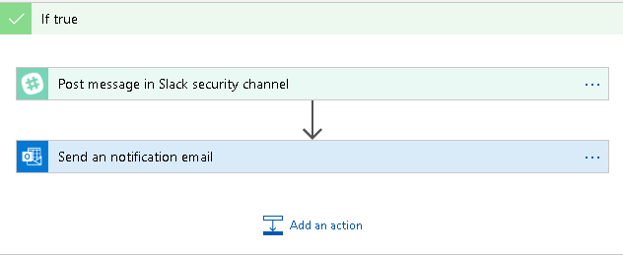
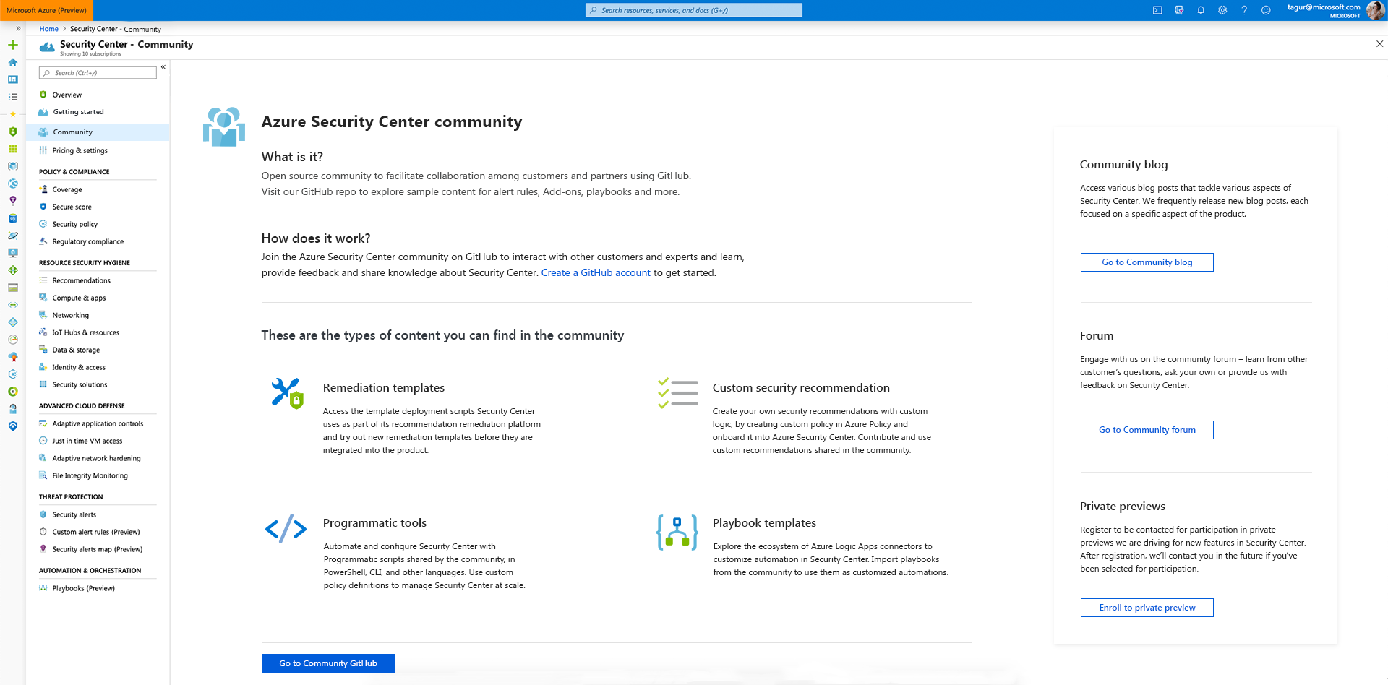
Automate workflows with ASC
Automate workflows with ASC
Trigger playbooks based on ASC recommendations and alerts
Built-in playbooks, build your own with Azure Logic apps
New community hub
Share workflows and remediation policies with the community the things that you’ve built
Learn what others did and deploy directly to Azure
Automate and script through API and PowerShell

Slide 28
Protect your workloads against threats: a go-do list
01
02
03
Good hygiene comes first, strengthen your cloud security posture
Turn on threat protection for all cloud resources
Reduce attack surface for VMs with JIT, Network and app controls
04
05
Integrate alerts into your SIEM & notify app owners
Identify root cause and drive new security hygiene up

Slide 29
Azure security center Ignite 2019 announcements
Enhanced threat protection for your cloud resources with security center
Support for threat protection & vulnerability assessment for SQL DBs running on Azure IaaS VM
Built-in vulnerability assessment with Security Center Standard
Container security for Azure Kubernetes Services with Azure Security Center
Threat Protection for Azure key vault in Public Preview in North America Regions
Malware reputation screening as part of ATP for Azure Storage
Extending Security Center’s coverage with platform for community & partners
Enhanced cloud security posture management
Secure score simplified
Support for customer created assessments
Quick remediation for bulk resources
Automatic assessment of NIST SP 800-53 R4, SWIFT CSP CSCF v2020, Canada Federal PBMM and UK Official together with UK NHS
Implement security faster with Security Center
Workflow automation with logic apps
Improved reporting and export for Security Center alerts and recommendations
Auto-discover, onboard and protect your AWS EC2 instances with Azure security center
Onboard on-prem servers to security center from Windows Admin Center
App
Containers
Network
SQL
Access
Partners
IoT
Compute

Slide 30
Azure security center sessions at Ignite
BRK3188
Protect your cloud workload from threats using Azure Security Center
Tuesday, Nov. 5 (10:30 – 11:15 AM)
BRK3187
Manage your cloud security posture and monitor your compliance
with Azure Security Center
Tuesday, Nov. 5 (2:15 – 3:00 PM)
BRK3191
End to end security for IoT
Thursday, Nov. 7 (3:30 – 4:15 PM)
SECO30
End-to-end cloud security for all your XaaS resources
Tuesday, Nov. 5 (2:00 – 2:45 PM)
BRK2148
Secure your virtual machines in Azure today
Monday,11/04 (3:15 PM- 4:00 PM)
SEC050
Top 10 Best Security Practices for Azure
Tuesday, Nov. 5 (4:30 PM - 5:15 PM)

Slide 31
Thank you!
To learn more, visit azure.microsoft.com/en-us/services/security-center/
ASC Tech Community Page

Slide 32
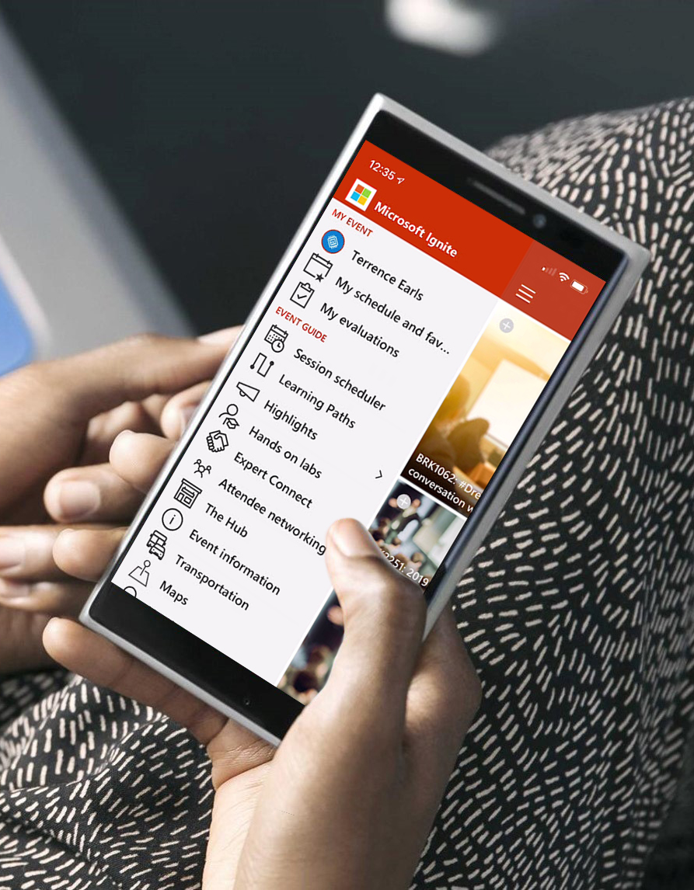
Please evaluate this session Your feedback is important to us!
Please evaluate this session through MyEvaluations on the mobile app or website.
Download the app: https://aka.ms/ignite.mobileapp
Go to the website: https://myignite.techcommunity.microsoft.com/evaluations

Slide 33
Visit aka.ms/MicrosoftIgnite2019/BRK3188
Download slides and resources
Access session recordings in 48 hours
Ask questions & continue the conversation
Find this session in Microsoft Tech Community

Slide 34
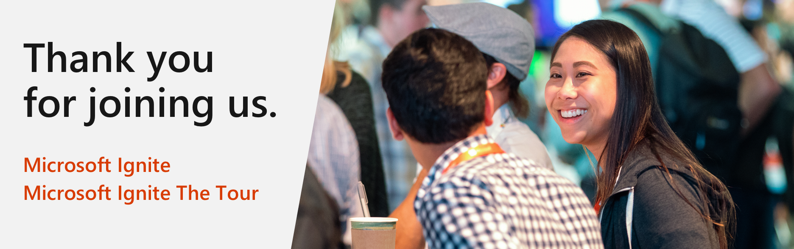
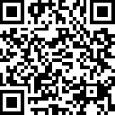
Microsoft Ignite The Tour:
Free Certification Exam Offer
https://aka.ms/Freeexam

